Slide 1


























Pregnancy Associated Mortality
BIG DATA INFRASTRUCTURE –COURSEWORK -2
Joslin Gadde
Student ID : 20076078

Slide 2
The Problem
Increased Deaths due to under super visioned pregnant female health , Decreased healthcare access and attention among the public services
Among active-duty service members, suicide and drug overdose have recently emerged as leading causes of pregnancy-related deaths.
Multiple health conditions like Cardiovascular disease , Cancer , Mental health issues were important and has an impact during pregnancy if left unsupervised or undiagnosed
According to New Data on Pregnancy-Related Deaths (2025), Native American and Alaska Native women experienced the highest age-standardized annual and overall mortality rate, at 106.3 deaths per 100,000 live births, with non-Hispanic Black women following at 76.9 deaths per 100,000 live births

Slide 3
The Problem
Pregnancy-related deaths are often preventable with timely access to quality medical care..
Racial and ethnic minorities, as well as residents of disadvantaged boroughs, often face structural barriers: lower health insurance coverage, fewer nearby healthcare facilities, and limited culturally competent care.
Maternal mortality not only causes personal tragedy but also impacts families, communities, and the economy, increasing healthcare costs and perpetuating cycles of poverty. (Romano et al., 2019).

Slide 4
Justification for the Data Set
Public Health Importance
Awareness Campaigns
Public health intervention
Potential for Predictive Analysis
Policy Making
Geospatial HealthCare Plans
Addressing a Particular issue
Focused Prevention Care
Problem Management Schemes
Research and Academic Value
Medical decision Support systems
Practical Relevance in Health care and informatics

Slide 5
Technical Solution Development
Kaggle || Data.Gov.In || Data.Gov.UK
These are the websites used for selecting and downloading the datasets on Pregnancy associated mortality and its effects and causes which in end had provided an overview on preventive care
LOD
(Learn on Demand)
Technical Constraints
Data entries
As for this project I would be using Learn on demand provided by the university facility which incorporates the sufficient technologies and dependencies.
Managing multiple large datasets and complex queries for desired outcome has been a challenge on Learn on Demand.
Extracted data sets are with diverse data entities which highlighted the analysis and helped to drive on a powerful conclusion.

Slide 6



Technical Solution Development (Core components )
Apache Hadoop is an open-source framework that enables distributed storage and processing of large datasets across clusters of computers.
HDFS – The Hadoop Distributed File system is used and made it possible to manage massive datasets efficiently while ensuring fault tolerance by replicating data across the cluster.
Connection to sandbox environment using PuTTy , an SSH client.
Host: sandbox.hortonworks.com , Port : 2222 and user as root
This Photo by Unknown Author is licensed under CC BY-SA

Slide 7

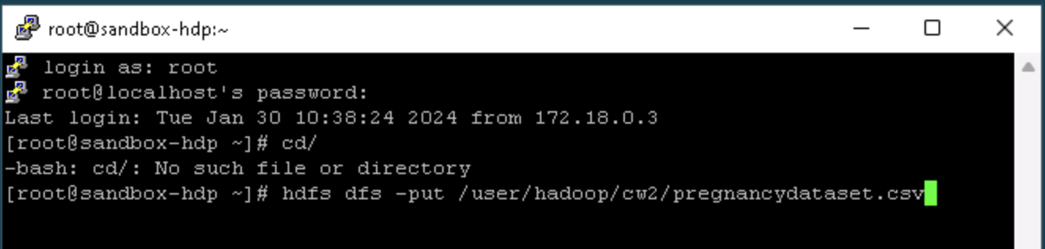

Technical Solution Development Core components (SSH Shell - PuTTY)
Using the PuTTY , logged into sandbox shell successfully and can now the files as in datasets be transferred from local system to the HDFS .

Slide 8
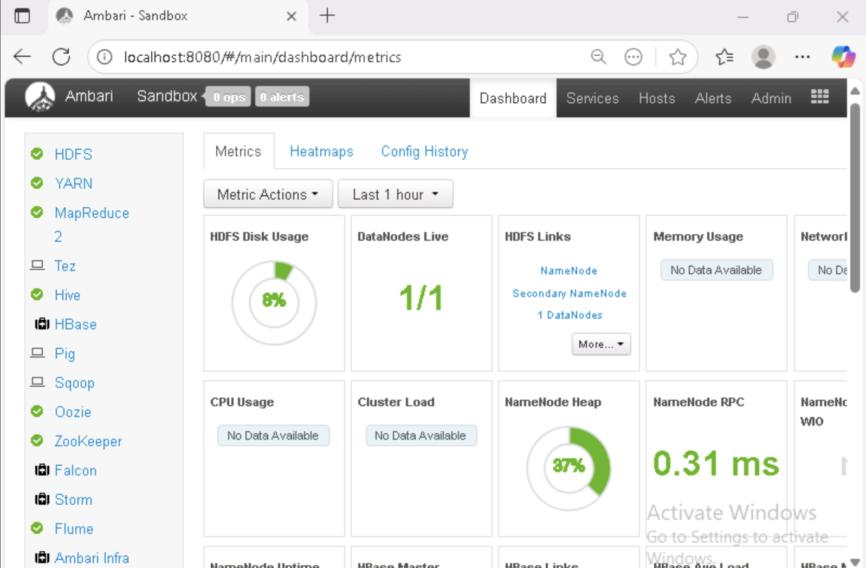
Technical Solution Development Core components (Ambari Hive and Zeppelin)
Once the data sets are uploaded to HDFS , the data can be viewed and processed via Ambari Hive UI.(http://localhost:8080)
Ambari Hive provides wide range of features to support data processing large data sets, creating tables and querying.
Zeppelin – is used for data visualization with SQL ,is directly linked to Ambari hive and loads the tables and performs the queries and outputs with graphical visualization which helps with data analysis

Slide 9

Technical Solution Development Flow Chart
Raw Data sets
Data sets extraction
Local System to Hadoop
Uploading files to Apache Hadoop
Ambari Hive
Data Processing
Zeppelin
Data Visualization

Slide 10
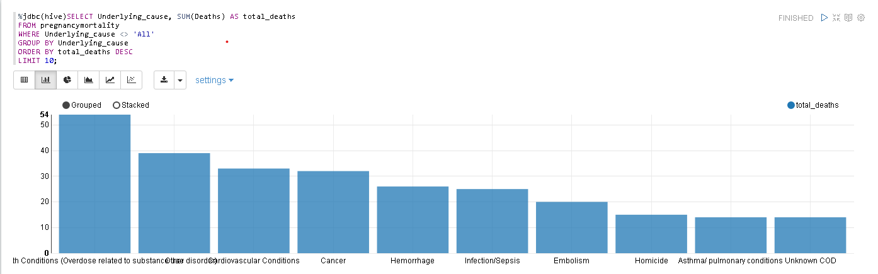
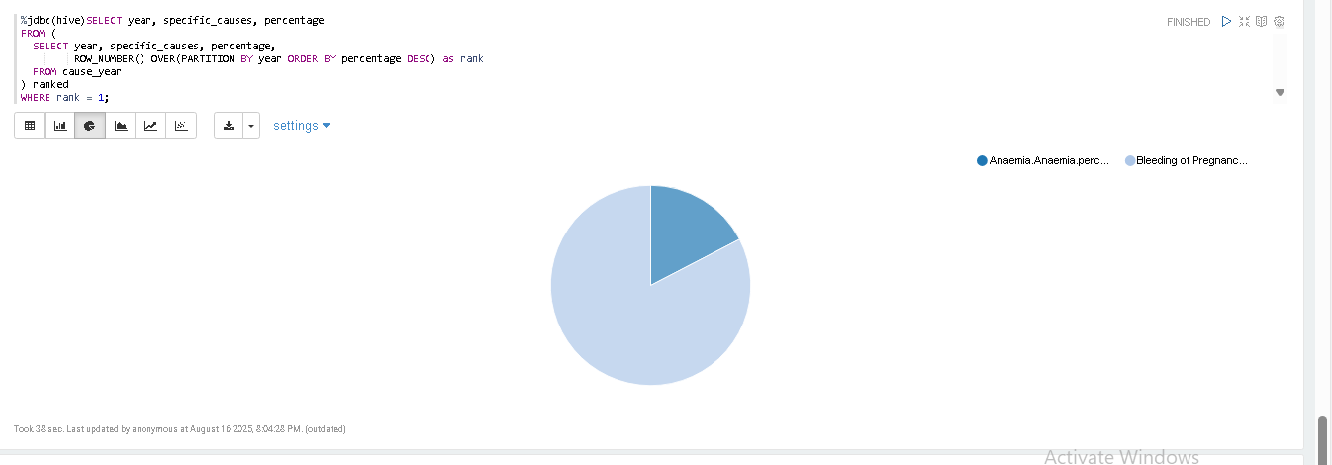
Analysis and Insights
Untreated conditions leads to risks during delivery and caesarian.
Anemia and Bleeding during pregnancy- Needs preventive care and immediate attention for pregnant females.
Hameed et al. (2015) highlight that cardiovascular disease—including cardiomyopathy—is a significant contributor to pregnancy-related mortality in California, particularly among African American women, those with substance use, and those who are obese

Slide 11
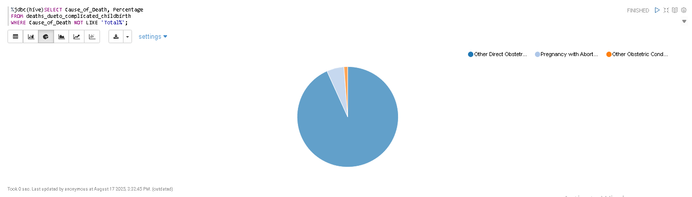
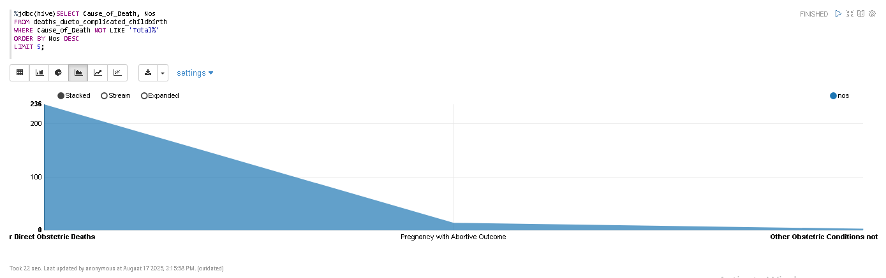
Analysis and Insights
Deaths due to complicated childbirth
Direct Obstetric is main cause while Abortion is secondary.
Insights – Safe Abortion services & emergency maternal care

Slide 12
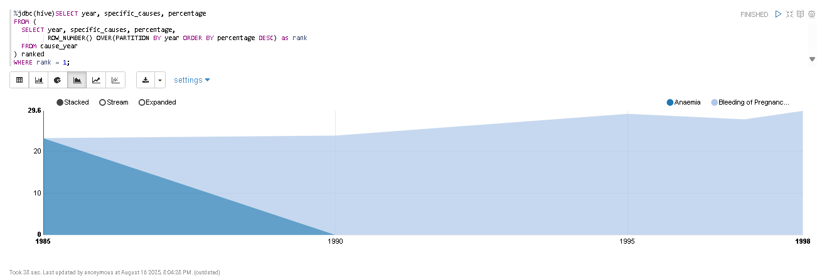
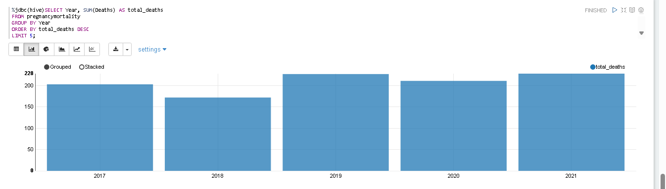
Analysis and Insights
Years with Maximum Maternal deaths- shortage of maternal care resources form 2019 and measures needs to be taken to reduce the recurrence
Merkt et al. (2021) identified significant disparities in pregnancy-related deaths across urban and rural areas in the United States

Slide 13
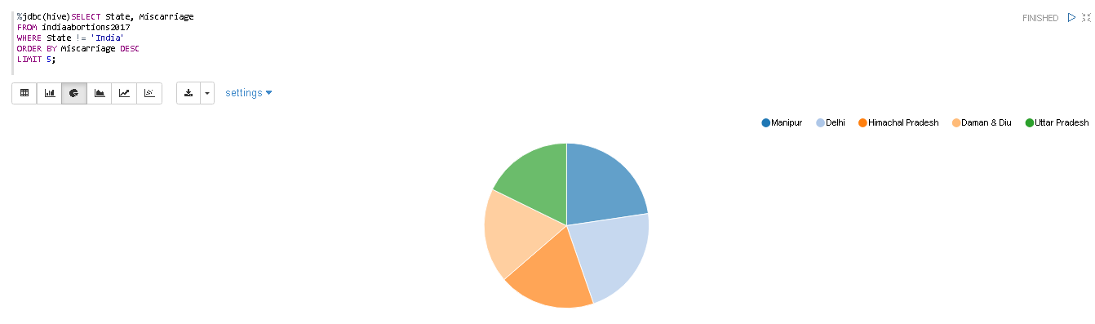
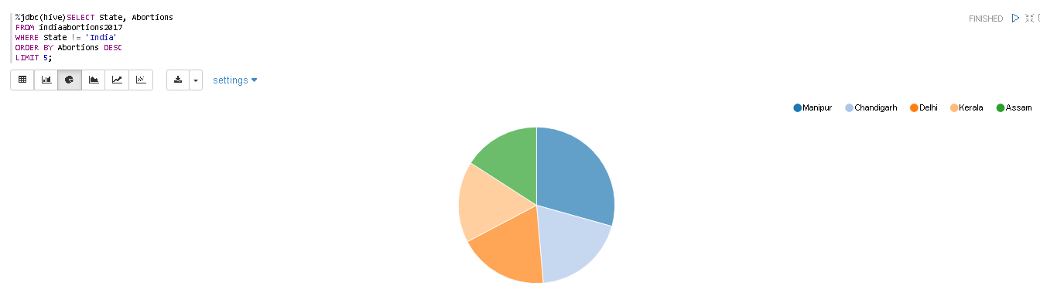
Analysis and Insights
Miscarriages and Abortions in India during 2017 were spiked due to lack of awareness and prenatal care, mostly due to forced pregnancies and Child marriages.
Miscarriage
Abortion

Slide 14
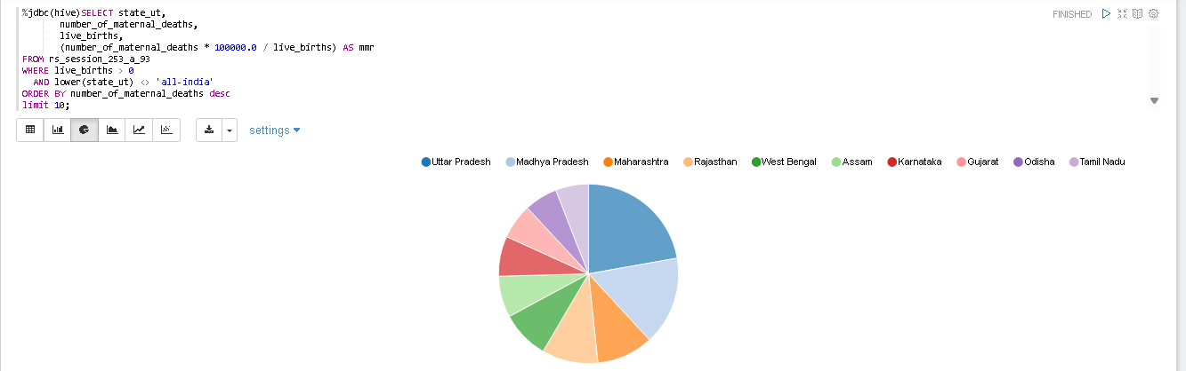
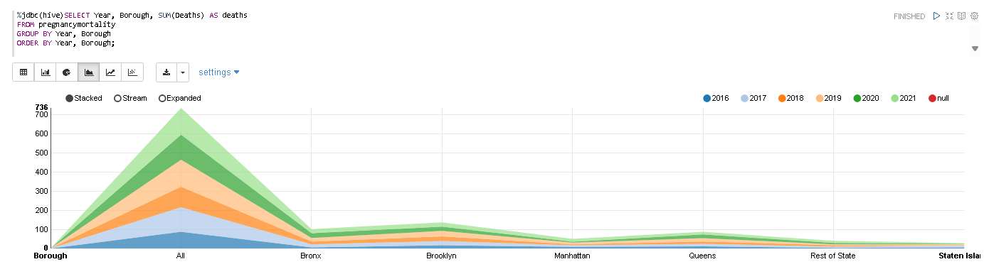
Analysis and Insights
Maternal deaths vary from state to state and country to country and the needs , preventive care should be enforced accordingly.
As the medical policies varies from governance , this should be taken in consideration as per medical statistics and to control or grow the population .
India
United States

Slide 15
Conclusion
This study investigated the primary determinants of maternal mortality, focusing on complications associated with pregnancy such as abortion, miscarriage, and delivery-related risks. The analysis was conducted using multiple datasets processed within a big data framework to uncover trends and patterns in maternal health outcomes.
Data ingestion, querying, and management were facilitated through PuTTY (SSH client) and Ambari Hive, while Apache Zeppelin enabled interactive exploration, visualization, and interpretation of the results. Hive and Zeppelin were selected due to their usability, strong integration with HDFS, and in-built visualization support, whereas alternatives such as PySpark, Power BI, and MapReduce were excluded because of their relative complexity and limited suitability for exploratory analysis in this context.
The results underscore the urgent need for targeted interventions in several global regions, where maternal mortality remains disproportionately high. Strengthening preventive prenatal care, expanding healthcare infrastructure, and implementing awareness campaigns are critical steps toward reducing maternal health risks. The findings highlight how big data tools can provide actionable insights to guide policymakers, healthcare providers, and advocacy groups in addressing maternal mortality and improving pregnancy outcomes.

Slide 16
References
New Data on Pregnancy-Related Deaths (2025) ‘New Data on Pregnancy-Related Deaths’, Nursing for Women’s Health, 29(4), pp. 210–215. Available at: https://doi.org/10.1016/S1751-4851(25)00129-1.
Romano, C.J., Hall, C., Bukowinski, A.T., Gumbs, G.R. and Conlin, A.M.S., 2019. Pregnancy-associated and pregnancy-related deaths in the United States military, 2003–2014. American Journal of Obstetrics and Gynecology, 221(5), pp.477.e1–477.e9. https://doi.org/10.1016/j.ajog.2019.06.042
Merkt, P.T., Kramer, M.R., Goodman, D.A., Brantley, M.D., Barrera, C.M., Eckhaus, L. and Petersen, E.E., 2021. Urban-rural differences in pregnancy-related deaths, United States, 2011–2016. American Journal of Obstetrics and Gynecology, 225(2), pp.183.e1-183.e16. https://doi.org/10.1016/j.ajog.2021.02.028
Hameed, A.B., Lawton, E.S., McCain, C.L., Morton, C.H., Mitchell, C., Main, E.K. and Foster, E., 2015. Pregnancy-Related Cardiovascular Deaths in California: Beyond Peripartum Cardiomyopathy. American Journal of Obstetrics and Gynecology, 213(3), pp.379.e1–379.e10.

Slide 17
Key Features Demonstrated
https://drive.google.com/file/d/1dHblJF1Euq5FFVOkbUDVDj3r21i0dGCD/view?usp=drive_link

